Slide 1
Cardiac Vein Mapping for PVC
VT Symposium 2021
연세의대 용인세브란스병원 심장내과
엄재선

Slide 2
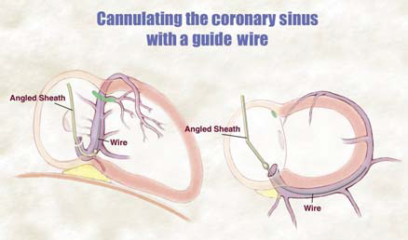
Anatomy of Cardiac Veins
GCV
VoM
AIV
GCV
LCV
AIV
VoM
PVV
CS
LCV
MCV
CS
SCV
SCV
PVV
MCV
LAO
RAO
A Habib, et al. Europace. 2009;11:v15-21

Slide 3
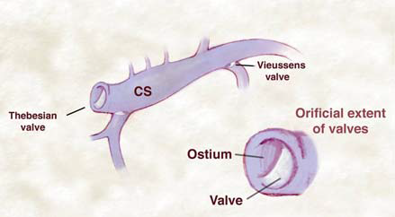
Valves in the Cardiac Veins
VoM
GCV
LCV
SCV
MCV
A Habib, et al. Europace. 2009;11:v15-21

Slide 4
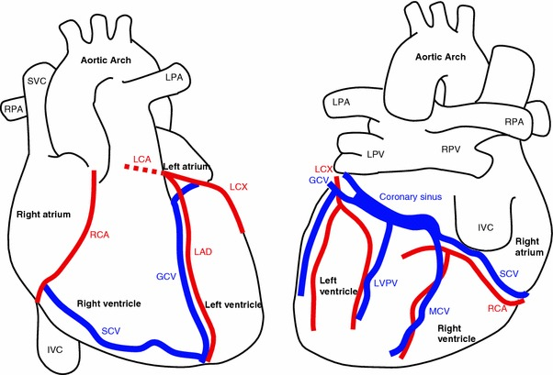
Coronary Arteries & Cardiac Veins
LM
LCx
LCx
GCV
VoM
CS
RCA
LAD
AIV
LCV
SCV
PVV
MCV
RCA
SCV

Slide 5
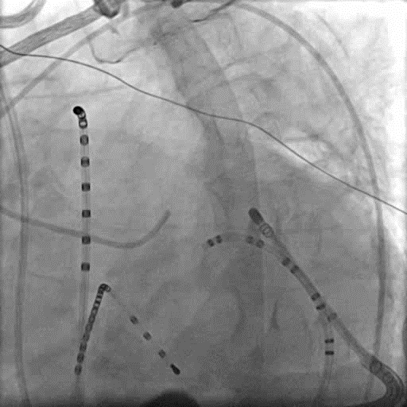
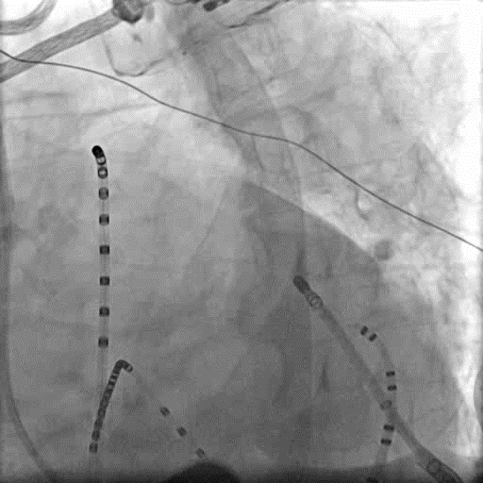
LV Summit
LAD
AIV
GCV
LCx
Coronary Angiogram
Cardiac Venogram
Cardiac CT

Slide 6
ECG Features of PVC from AIV/GCV
LBBB pattern
Inferior axis
Early precordial transition
rS or “w” pattern in lead I
rS or QS in lead V1
R in lead V6
Precordial pattern break; abrupt loss of R in V2
MDI > 0.55
KM Park, et al. Pacing Clin Electrophysiol 2012;35:1516-27
D Chang, et al. J Cardiovasc Electrophysiol 2020;31:2668-76

Slide 7
Mapping in Ant Interventricular & Great Cardiac Veins
Usual catheters position:
  Lasso catheter in RVOT
  Decapolar catheter in distal great cardiac vein
  2-Fr octapolar catheter in junction of AIV & GCV
Mapping area:
  RVOT → cardiac vein → LVOT (aortic cusp) → epicardium
  RVOT → LVOT (aortic cusp) → cardiac vein → epicardium
Mapping technique:
  Activation mapping with bi- and unipolar signals
  Pace-mapping

Slide 8
RFCA in Ant Interventricular & Great Cardiac Veins
Successful RFCA site
  Activation time from onset of QRS = 36.7 ± 8.0 ms
  Steep QS pattern in unipolar mapping
  QRS matching in more than 11 leads in pace-mapping
RFCA in anterior interventricular or great cardiac vein
  Left coronary angiography before RFCA; distance ≥ 5 mm
  Power = 23 (15–27) Watts
  Duration = 30 (23–39) sec
  Initial impedance = 244 (186–266) Ω
  High-flow irrigation in case of high impedance
K Nagashima, EK Choi, WG Stevenson, et al. Circ Arrhythm Electrophysiol 2014;7:906-12

Slide 9
Complications & Prevention
Intravenous or intramural thrombus
Cardiac tamponade due to cardiac vein rupture
  Power < 40 Watts
  Duration < 60 sec
  Initial impedance < 270 Ω
Coronary artery injury
  Distance of RFCA site from coronary artery ≥ 5 mm
YC Li, et al. Int J Cardiol 2013;167:2673-81
D Steven, et al. Int J Cardiol 2013;169:366-70

Slide 10
CASE
Patient: 70/M
C/C: Dyspnea on exertion & palpitation for 3 months
History:
  Underwent PCI at mLAD for STEMI in 2015
  Diagnosed with paroxysmal AF (CHA₂DS₂-VASc = 3)
Echocardiography:
  LVEF 60%, no RWMA
Medication:
  Apixaban 5mg bid, nebivolol 2.5mg qd, dronedarone 400mg bid, losartan 25mg qd
Notes:
6769930 최창열

Slide 11
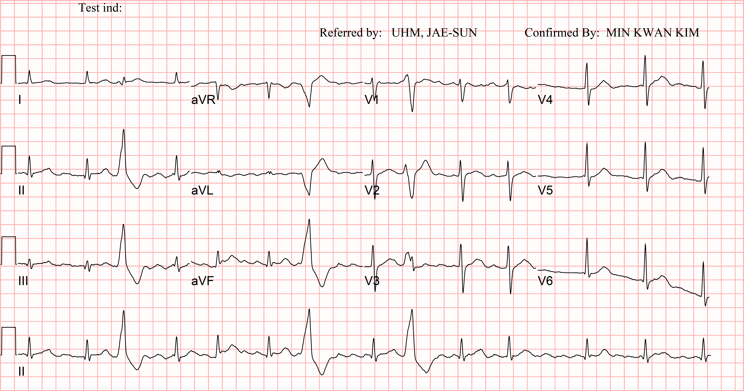
ECG

Slide 12
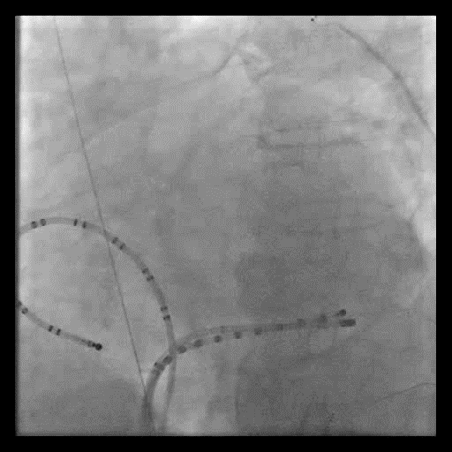
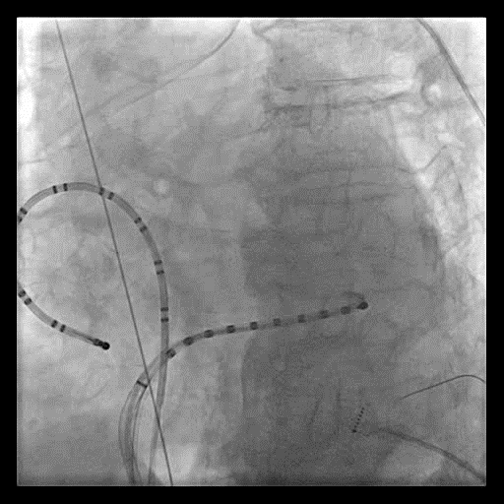
Catheter Placement in Coronary Sinus
Valve of Vieussens

Slide 13
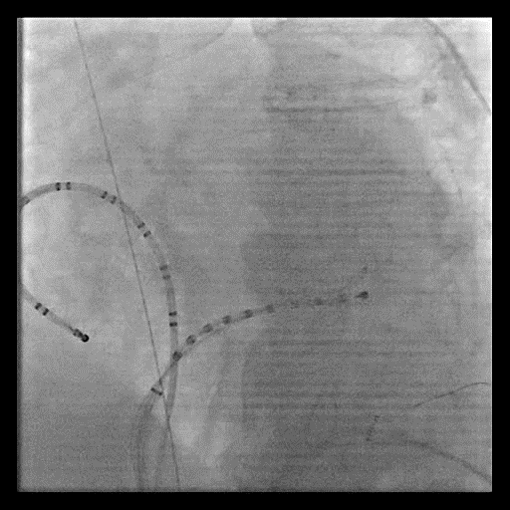
Passing Valve of Vieussens
with Judkins Right Catheter & Wire .035”

Slide 14
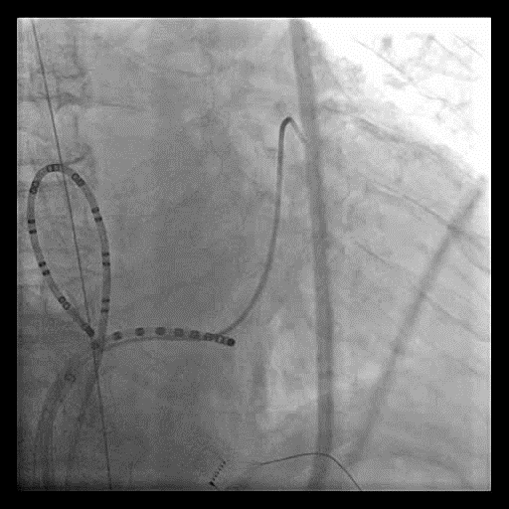
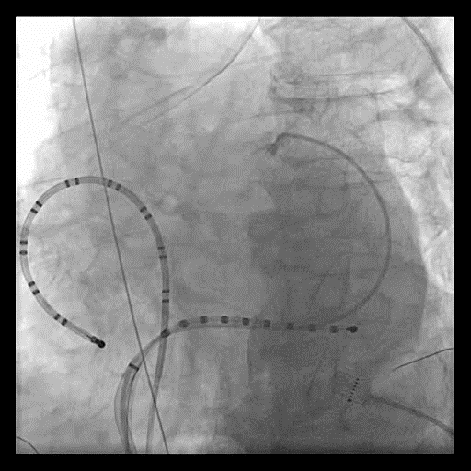
Cardiac Venogram with Judkins Right Catheter

Slide 15
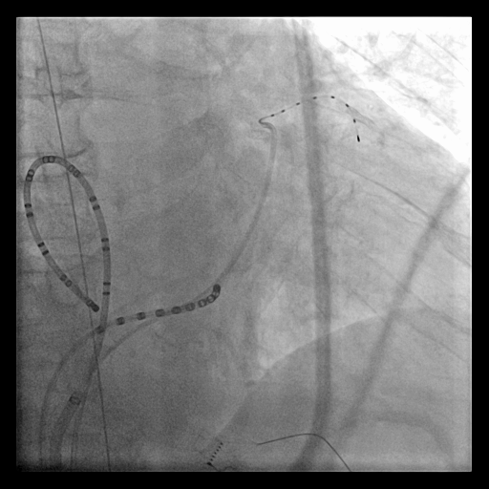
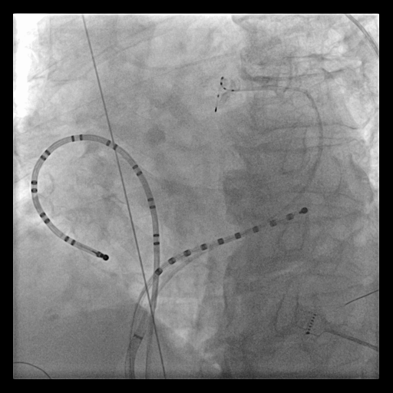
Position of 2-Fr Octapolar Catheter
2-Fr octapolar
catheter
2-Fr octapolar
catheter
Judkins right
catheter
Judkins right
catheter
Non-braided
SL-1 sheath
Non-braided
SL-1 sheath

Slide 16
PVC mapping in AIV & GCV

Slide 17
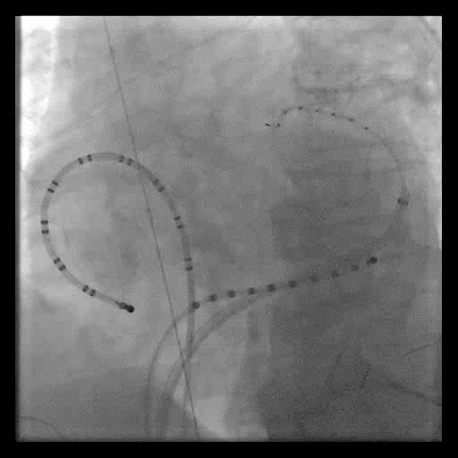
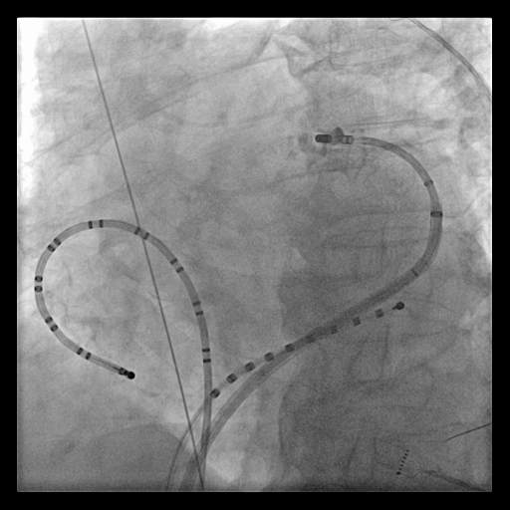
Exchange of Octapolar Catheter for Ablation Catheter
Tip of
SL-1 sheath

Slide 18
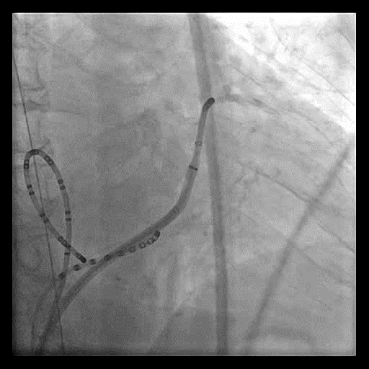

Cardiac Venogram with Ablation Catheter

Slide 19
RFCA at Junction of AIV/GCV

Slide 20
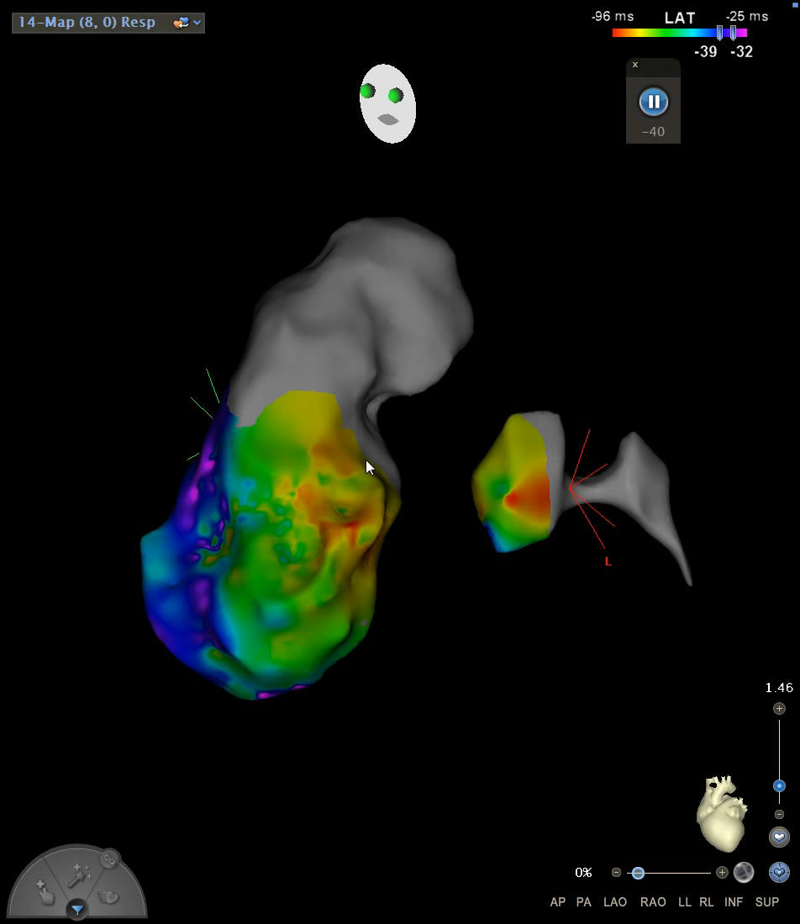
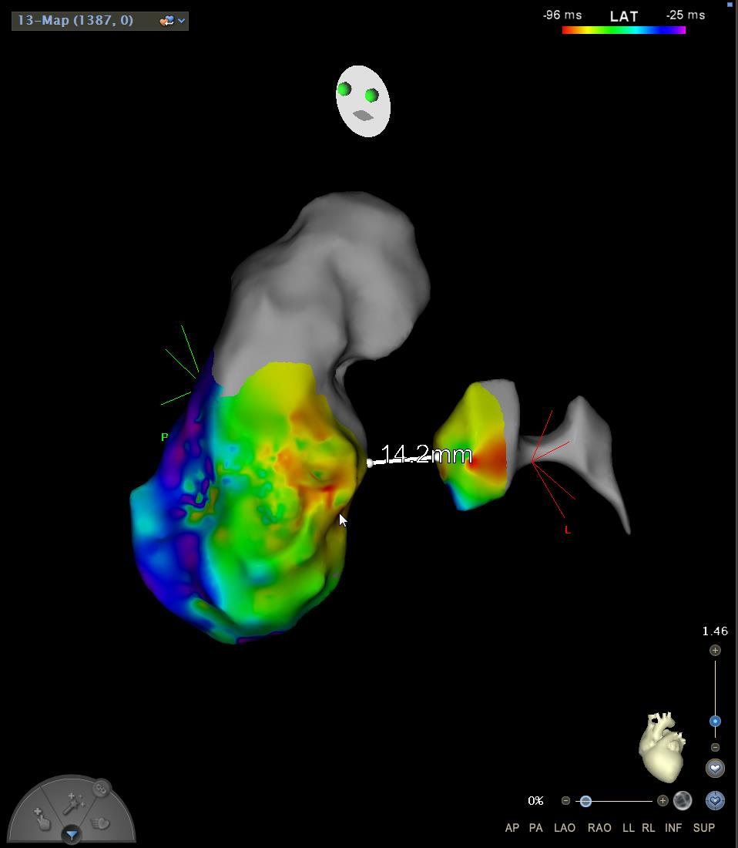
3D Mapping for PVC
Thanks to Su Kyung Oh

Slide 21
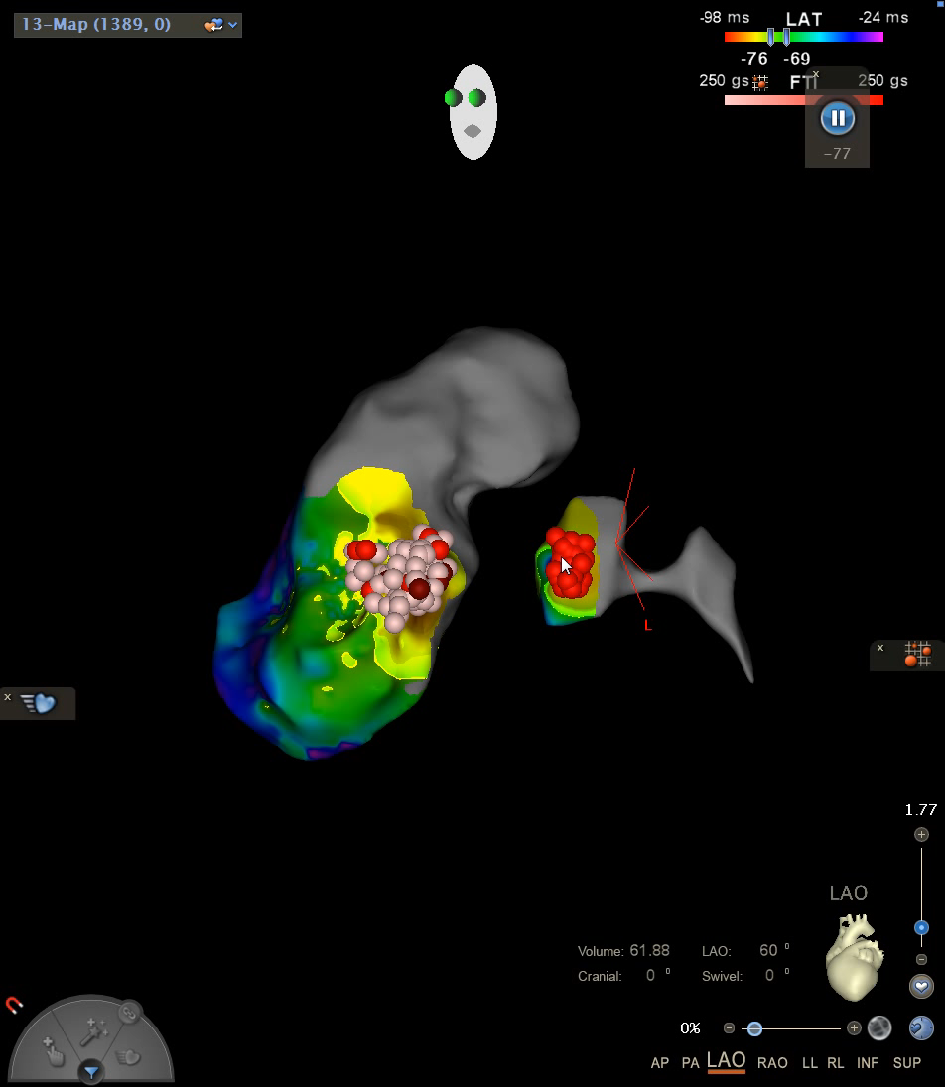
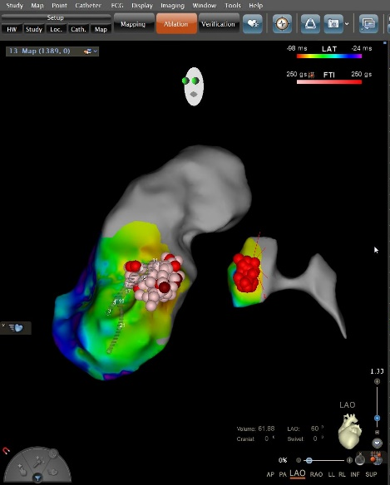
3D Mapping for PVC
Thanks to Su Kyung Oh

Slide 22
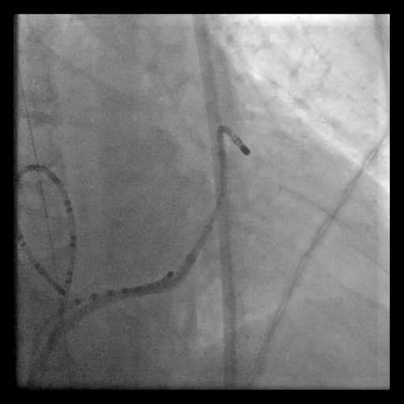
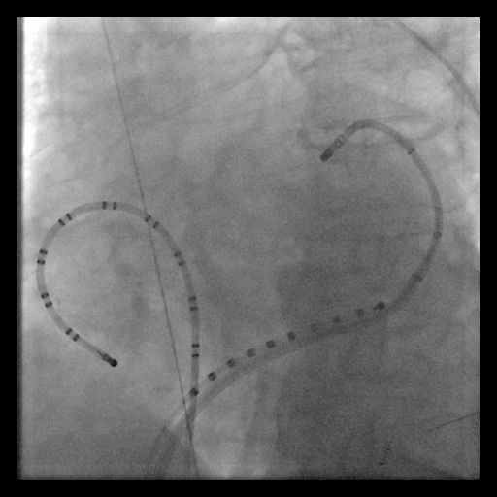
RFCA at Junction of AIV/GCV

Slide 23
Summary
ECG features
  rS or “w” pattern in lead I
  Precordial pattern break
  MDI > 0.55
Mapping in AIV/GCV
  Insertion of non-braided SL-1 sheath with ablation catheter to GCV → insertion of Judkins right catheter with .035” wire to AIV → cardiac venogram → 2-Fr octapolar catheter

Slide 24
Summary
Successful RFCA site in AIV/GCG
  Activation time from onset of QRS ≥ 25 ms
  Steep QS pattern in unipolar mapping
  QRS matching in ≥ 11 leads in pace-mapping
RFCA site in AIV/GCG
  Left coronary angiography before RFCA; distance ≥ 5 mm
  Power < 40 Watts
  Duration < 60 sec
  Initial impedance < 270 Ω
  High-flow irrigation in case of high impedance

Slide 25







Thank you!

